Slide 1


Script Editing Code Navigation
Ayala Goldstein
23-Jul-2020

Slide 2
Agenda
Script tab
Script viewer
Edit Step popup
Add command & function popup
Expression Resolver
Script Model
Script Instruction Types
Hands on

Slide 3
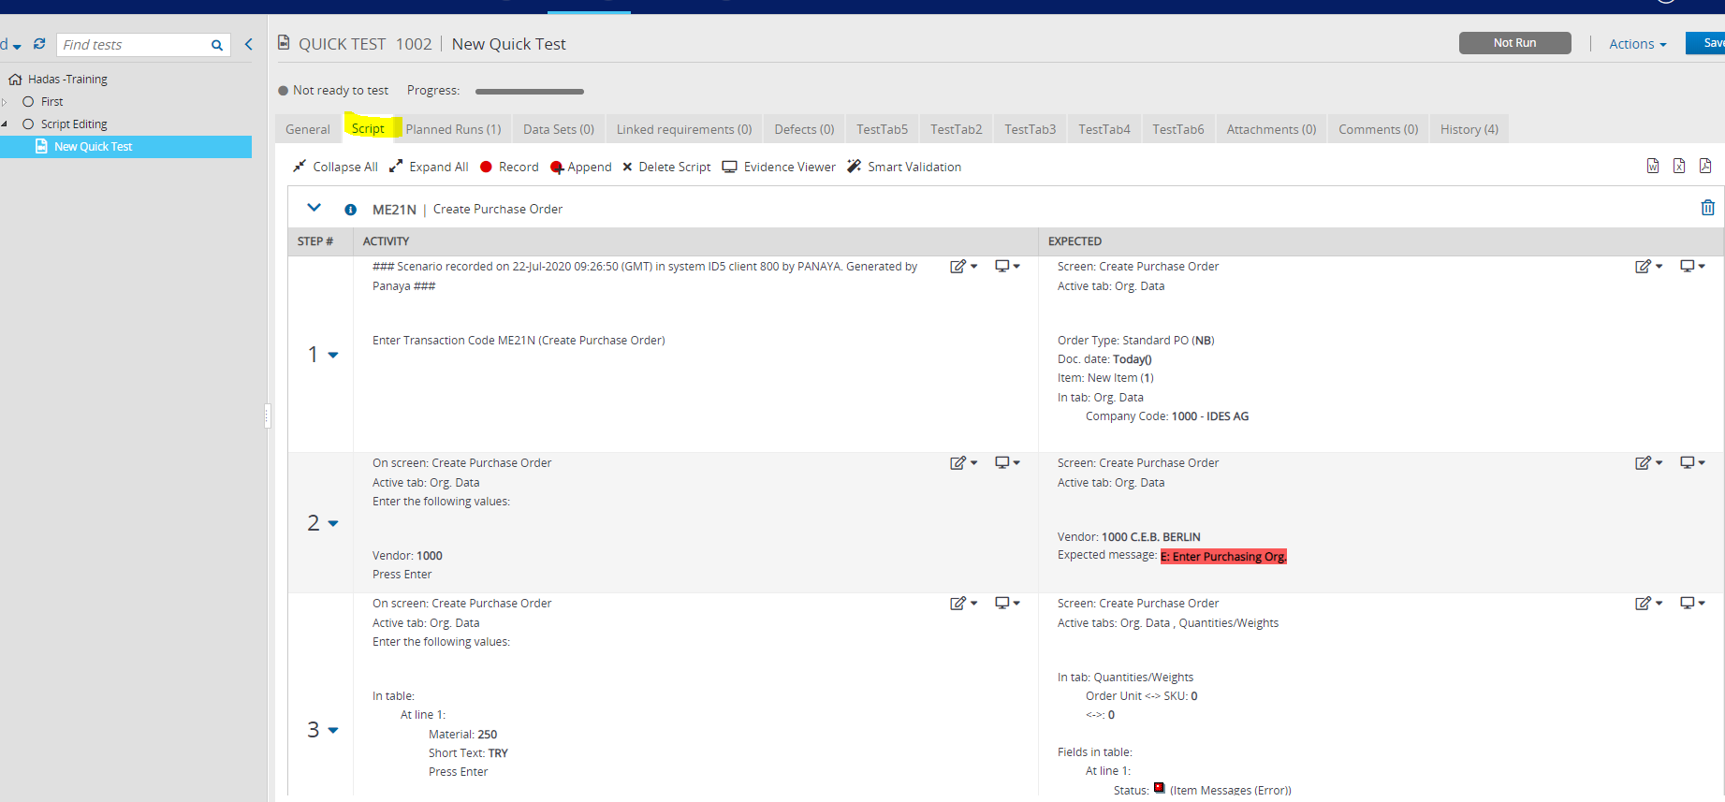
Open Script Tab

Slide 4
Open Script Tab - Code Navigation
Client Side:
scriptView.js & scriptView.html
Server Rest Call:
get script data: TestService.getScriptDetails(js file)
https://qaappprod9.panaya.int/rest/execution/scriptDetailsByTest/10120540?projectId=67117
Server Side:
GetScriptDetailsByTestBusinessLogic (java)
The return value: ScriptDetails

Slide 5
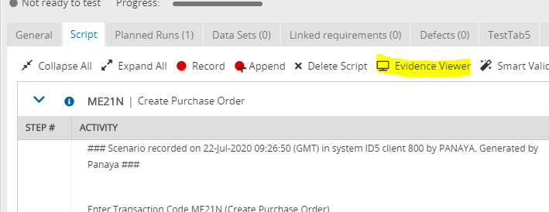
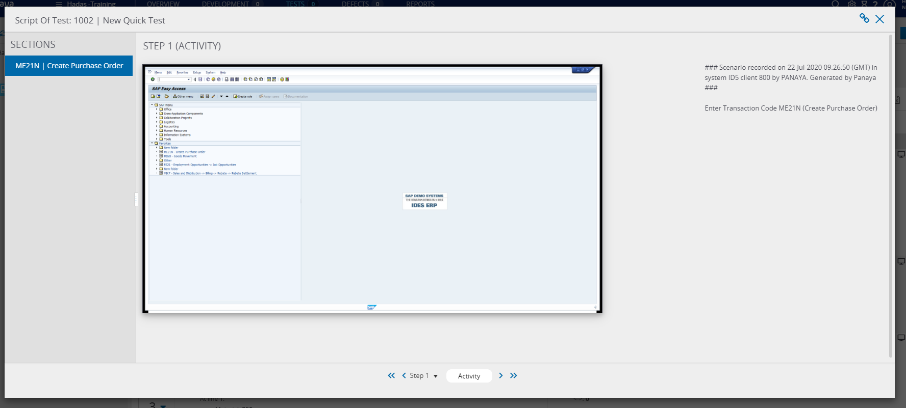
Open Script Viewer

Slide 6
Open Script Viewer - Code Navigation
Client Side:
ScriptViewerService.openScriptViewer (js file)
Server Rest Call:
No need , the script is already loaded in client side

Slide 7
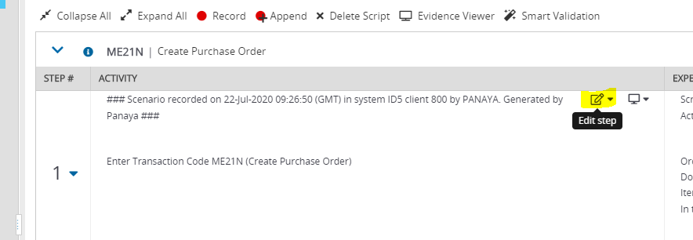
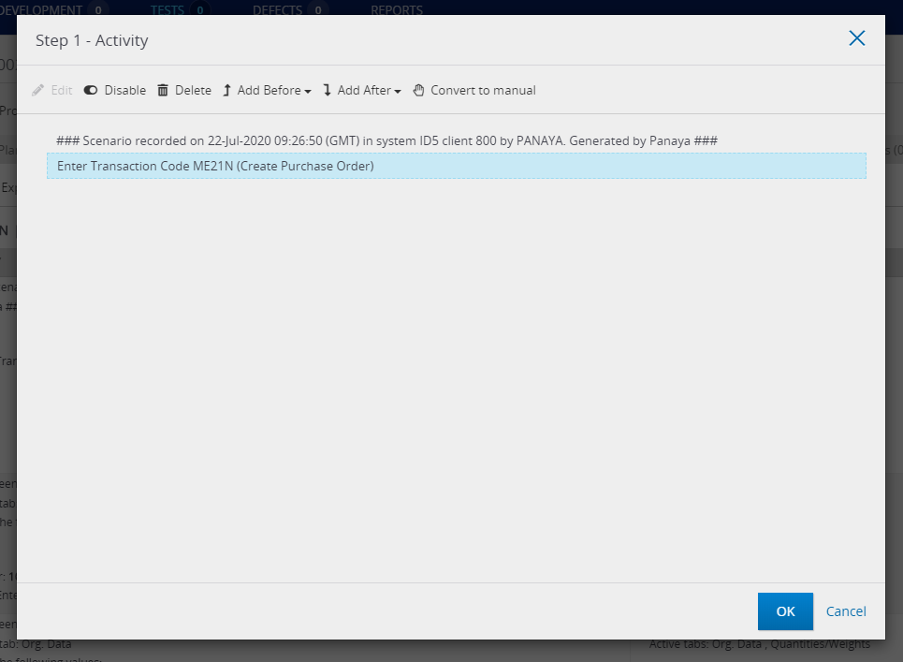
Edit Step

Slide 8
Edit Step - Code Navigation
Client Side:
scriptStepEditingPopup.html & scriptStepEditingController.js

Slide 9
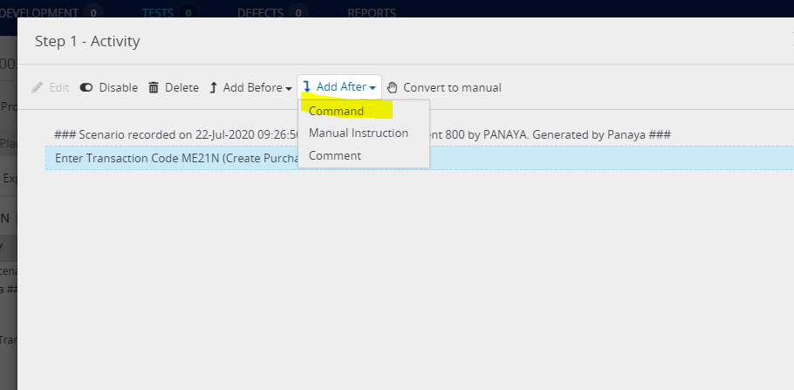
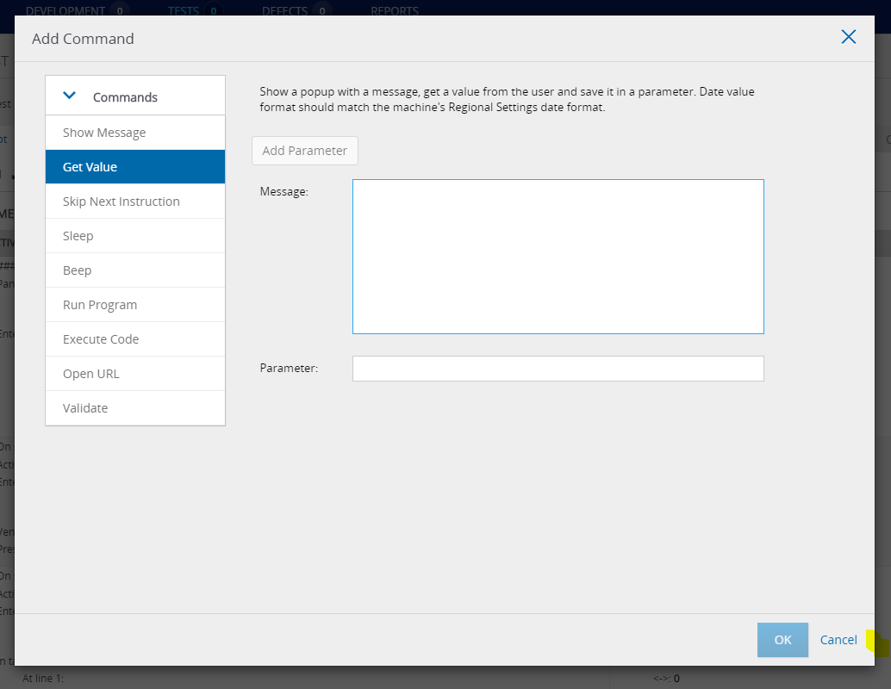
Add Command / Function

Slide 10
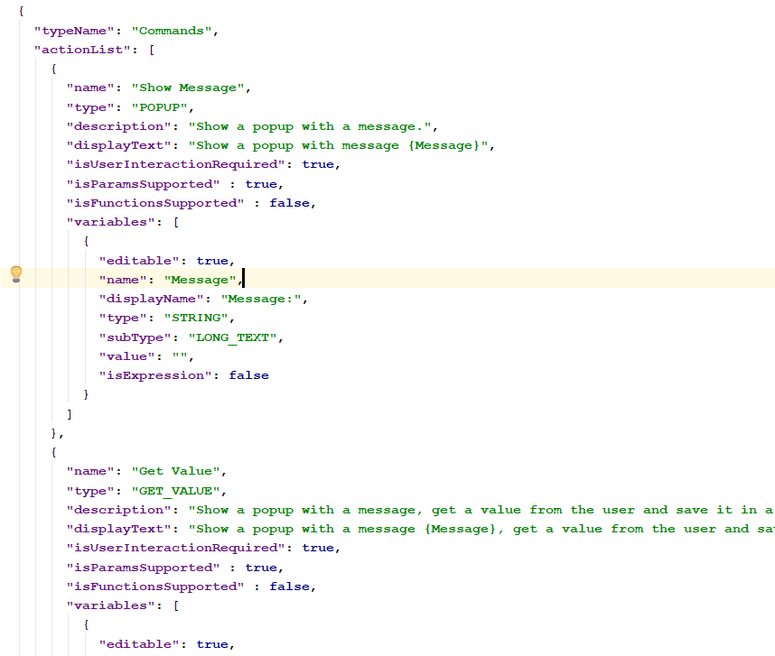
Add Command / Function - Code Navigation
Client Side:
scriptStepAddAction.html & scriptStepAddAction.js
Command & Functions List Provider:
commands.json & functions.json

Slide 11
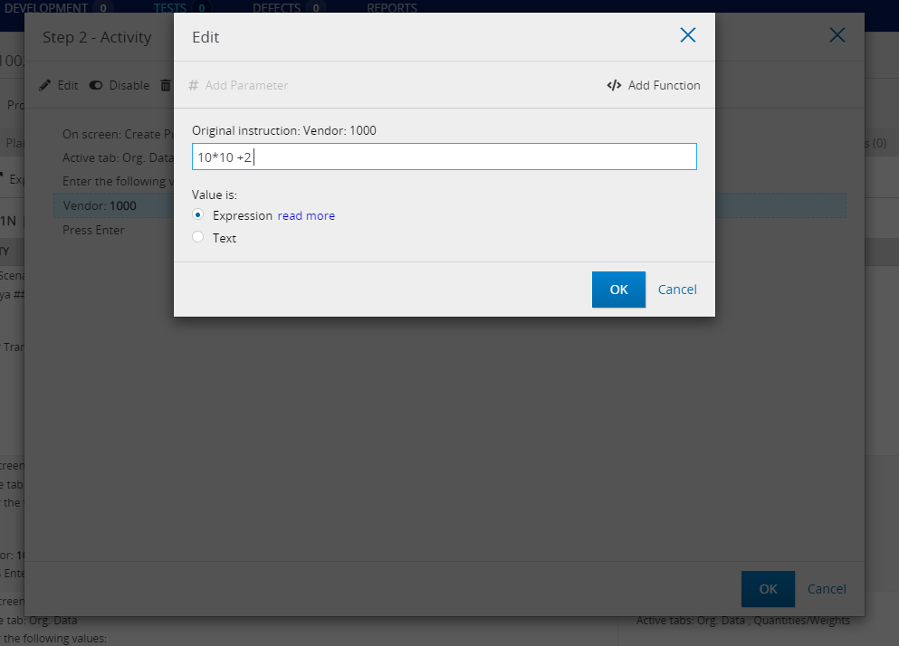
Expression Resolver

Slide 12
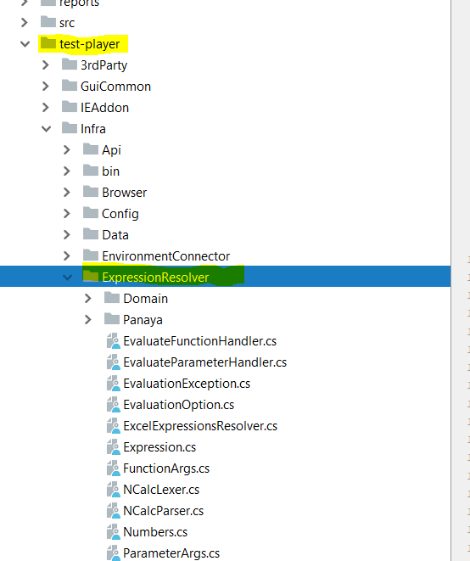
Expression Resolver- Code Navigation
Ncalc – 3rd party - .net side
https://archive.codeplex.com/?p=ncalc

Slide 13
Script Model - Code Navigation
Script.java
ScripSection.java
ScriptStep.java
List<ScriptSection>
List<ScriptStep>
List<ScriptBaseInstruction> activity
List<ScriptBaseInstruction> expected

Slide 14
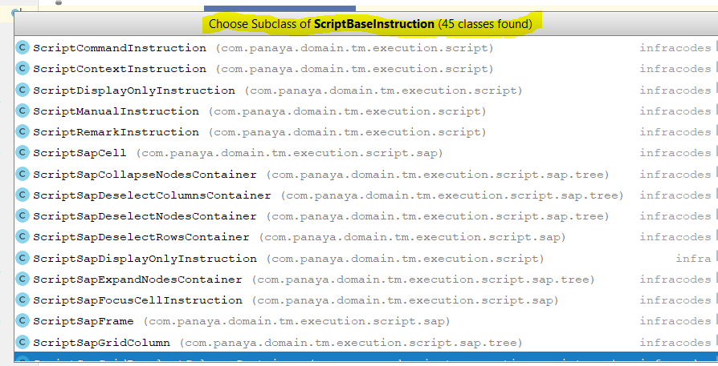
ScriptBaseInstruction.java
Is abstract class
Has 45 subclasses

Slide 15
ScriptBaseInstruction.java - Main Types
ScriptBaseInstruction.java
ScriptSapInstruction.java
ScriptCommandInstruction.java
ScriptWebInstruction.java
ScriptManualInstruction.java

Slide 16
Save Test & script changes – Code Navigation in serve side.
SaveExecutionTestBusinessLogic#saveTest
TmTestService#updateTmTest
TmScriptUpdater#UpdateScriptWithUserChanges

Slide 17
Hands On – Script Editing - Code
Create a QuickTest
In the script tab – create a new script
Add to the script command, manual instruction and comment instruction.
Put a break points in the code at the relevant places (previous slide).
Save the test
Follow up the save process and how we use the different types of instructions.

